Slide 1

NATURAL LANGUAGE PROCESSING(NLP) - SENTIMENT ANALYSIS
BY: MARTIN W. NGUGI
GITHUB LINK: https://github.com/martin-ngugi

Slide 2
TABLE OF CONTENT
BUSINESS UNDERSTANDING
MAIN OBJECTIVE
DATA UNDERSTANDING
MODELLING
CONCLUSION
RECOMMENDATION

Slide 3
BUSINESS UNDERSTANDING
Harnessing the potential of sentiment analysis in the context of customer feedback on Twitter is a crucial move toward improving corporate expansion, making well-informed choices, and maximizing profitability. In this project, our goal is to thoroughly investigate the sentiment expressed by Twitter users in their feedback towards companies. We will achieve this by employing Natural Language Processing (NLP) methods to uncover the range of sentiments and their significant impact on businesses. Our data source for this project will be Dataworld.
This project's goal is to construct a multiclass sentiment analysis classifier for tweets. The primary aim is to assess and classify tweets into three sentiment categories: positive, neutral, and negative. This analysis provides the means for businesses and individuals to grasp public sentiment, track brand image, and make well-informed choices.

Slide 4
MAIN OBJECTIVE
To develop a resilient model for sentiment analysis that assesses the sentiment of tweets by evaluating their content.

Slide 5
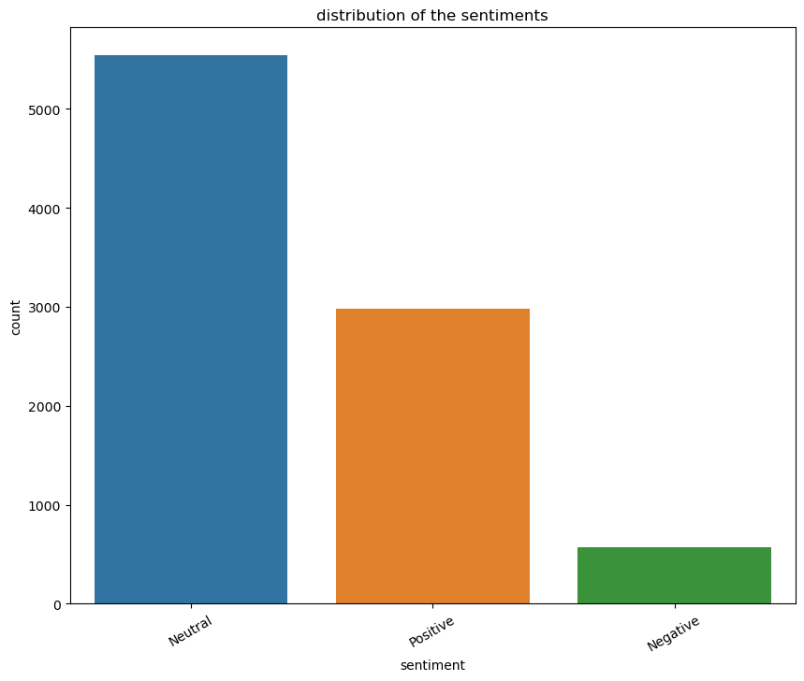
DATA UNDERSTANDING
The graph shows the sentiments distribution after mapping to Neutral, positive and Negative.

Slide 6
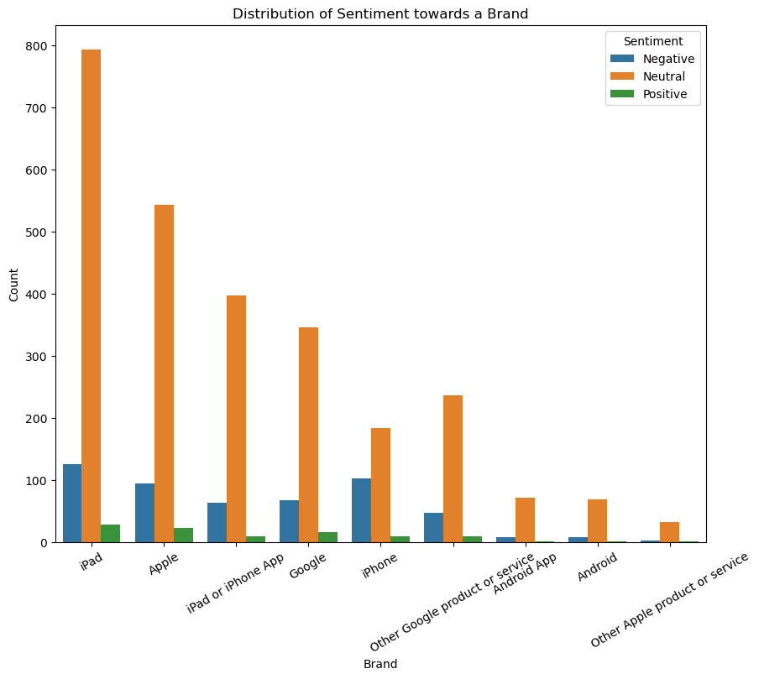
DATA UNDERSTANDING
The graph shows the sentiments distribution towards specific brands.

Slide 7
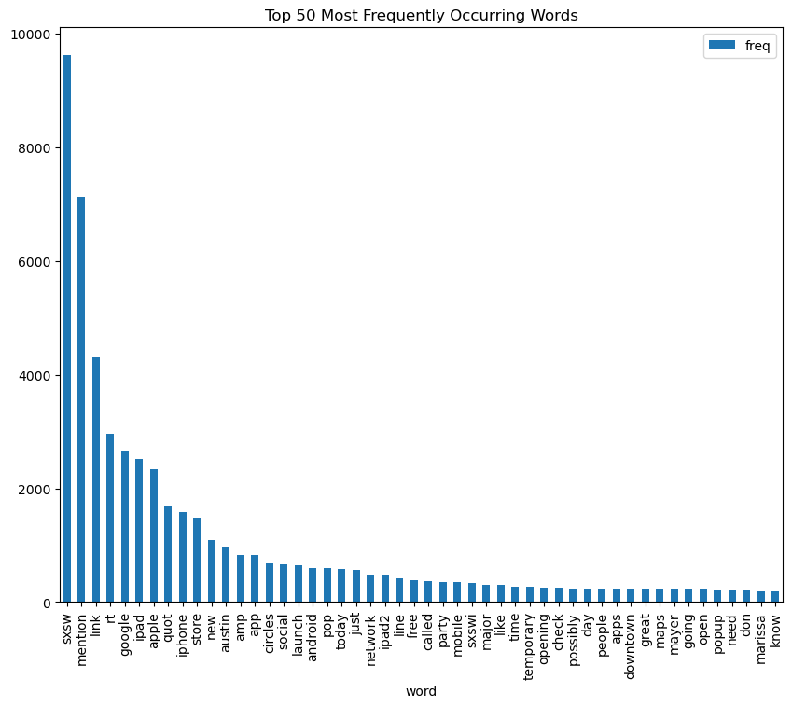
DATA UNDERSTANDING
The graph shows the Top 50 most frequently occurring/used words.

Slide 8
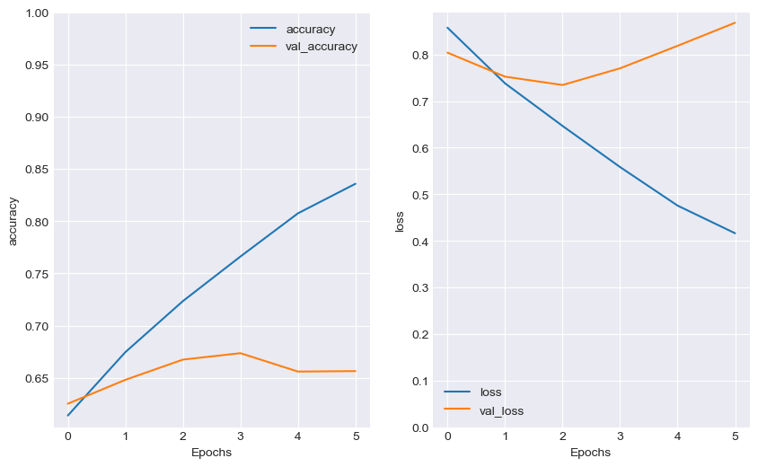
MODELLING - Neural Network Model
This is a neural network model which had an accuracy of 65.64%

Slide 9
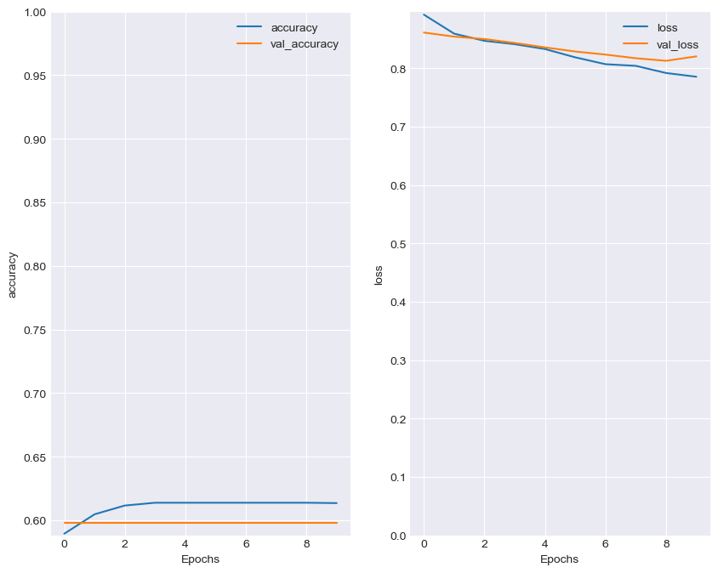
MODELLING - Tuned Neural Network Model
This is a tuned neural network model which had an accuracy of 59.79%

Slide 10
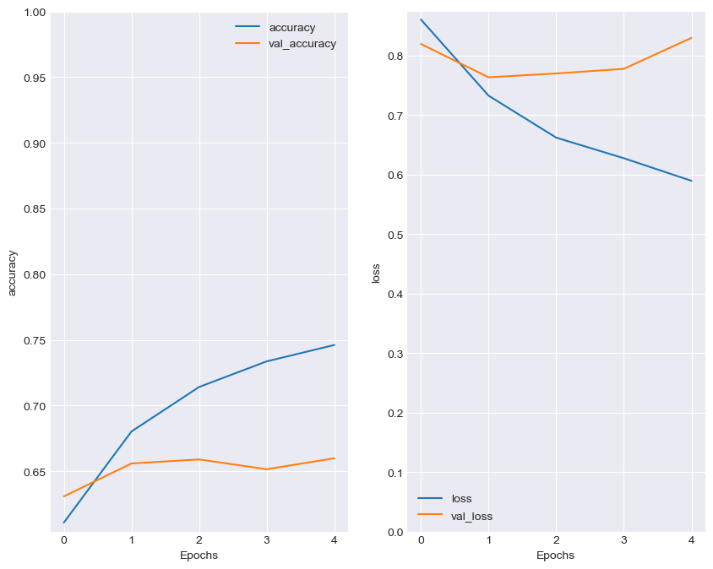
MODELLING - LSTM
This is a Long Short Term Memory (LSTM) which had an accuracy of 65.99%

Slide 11
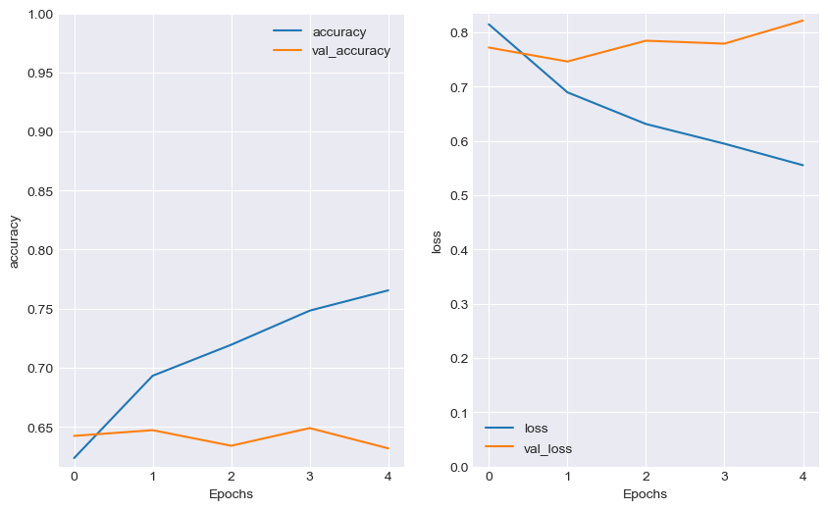
MODELLING -Tuned LSTM
This is a tuned Long Short Term Memory (LSTM) which had an accuracy of 63.18%

Slide 12
CONCLUSION
In this project, we considered various models for sentiment analysis of text data. We started with a basic model that uses neural networks (NNs) to store sequence information in text data.
We then experimented with more advanced models such as LSTM and tuned bidirectional LSTM to check if there is improvement of accuracy. Based on the accuracy results obtained above, the LSTM Model has an accuracy of 0.6599 which is the best of all.

Slide 13
RECOMMENDATION
To better enhance the model performance, we should consider exploring a model like Bidirectional Encoder Representations from Transformers(BERT), for sentiment analysis. The BERT models should have greater impact in NLP tasks which would or may result to even more better and accurate sentiment analysis results.

Slide 14
PRESENTED BY: MARTIN NGUGI
THANK YOU.

